Slide 1

Natural disaster Navigator
Joker Members:
Yinchu Wang, Yuehui Wu, Xinyue Zhang, Sile yang, Chong Dang, Jun Wang

Slide 2

Objective: The natural disasters present an uncontrollable and unpredictable hazard to life and property. Therefore, we intend to explore the data from different perspectives (i.e frequency, location, intensity, correlation) to see whether we could extract useful information.
​
Agenda:
1) Visualise and Analyse Worldwide Disaster Data
2) Using probabilistic model to investigate earthquake data
3) Business insights and Conclusion

Slide 3
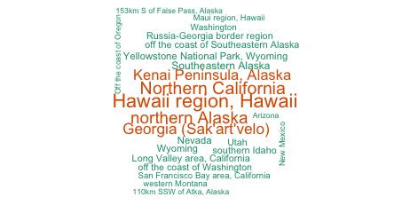
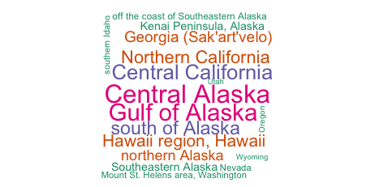
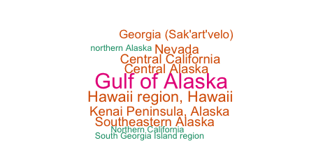
LowLevel
MediumLevel
ShinyApp
HighLevel

Slide 4
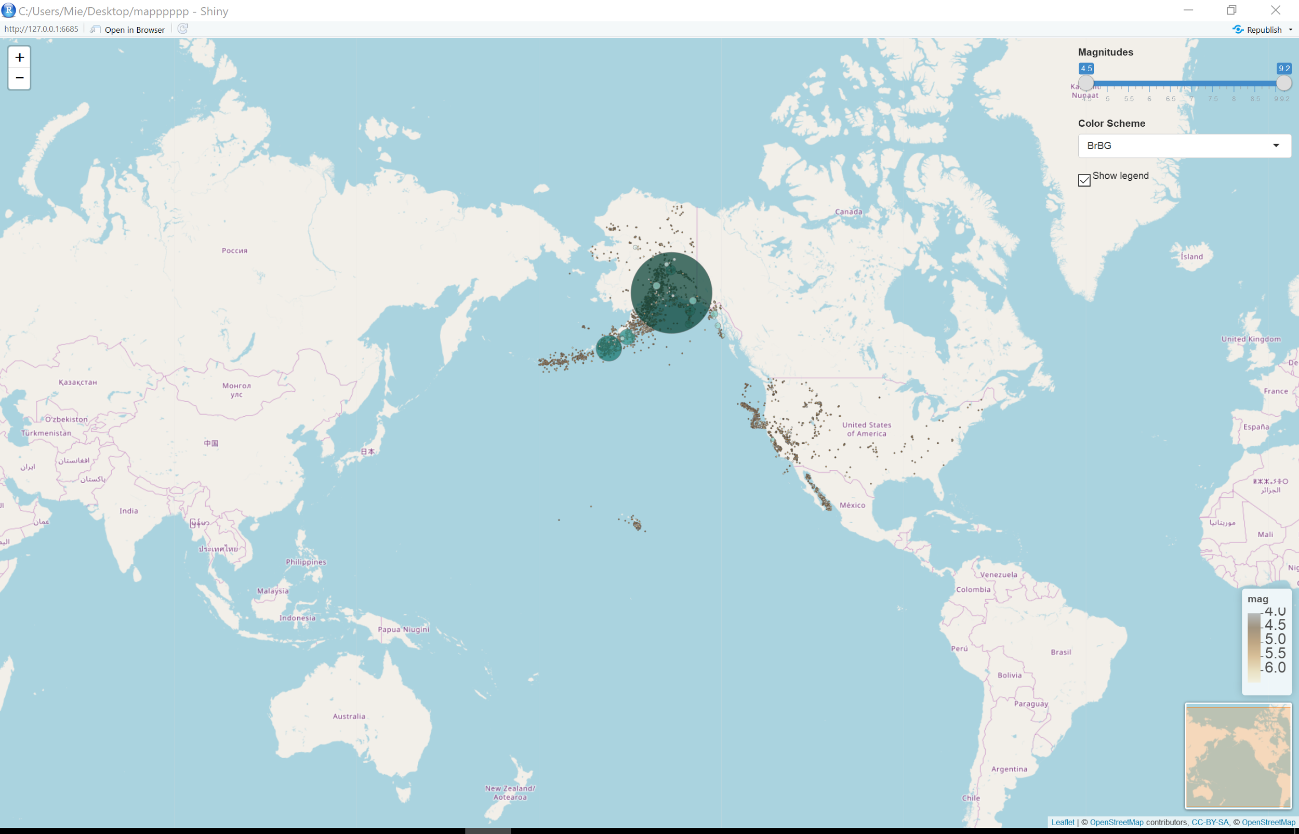
Earthquake in America from 1900 to 2017
Three clusters: Alaska, California, Hawaii
The radius and color of circle: magnitude of earthquake
The larger radius, the stronger color, the larger magnitude

Slide 5
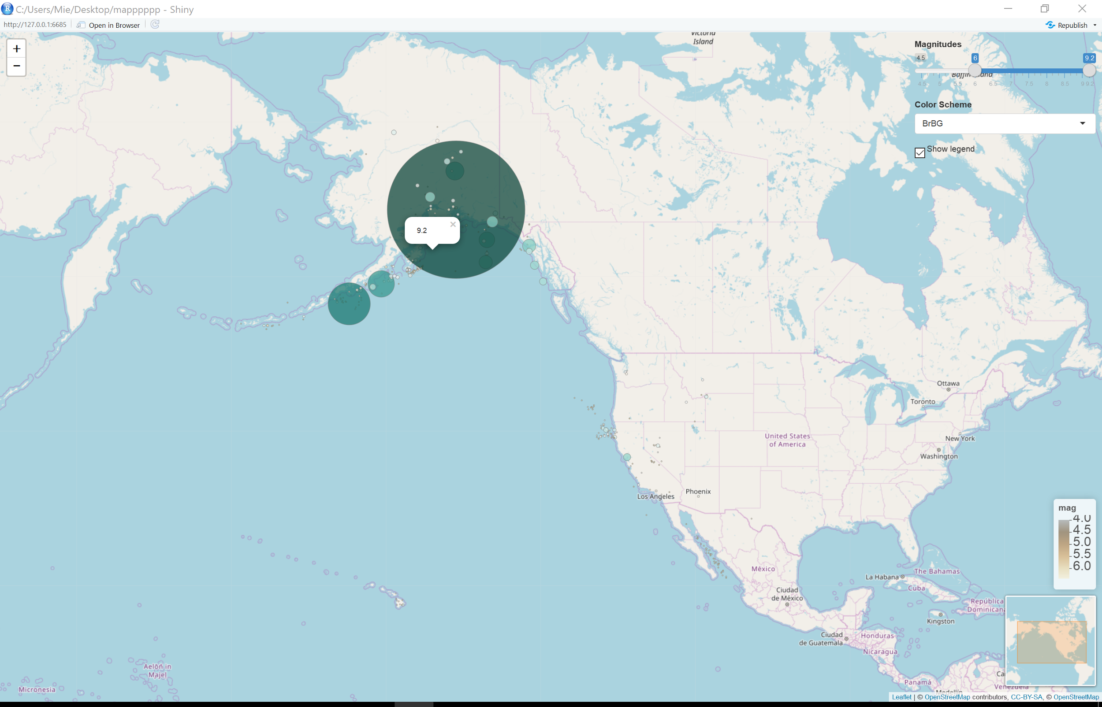
Magnitude greater than six

Slide 6
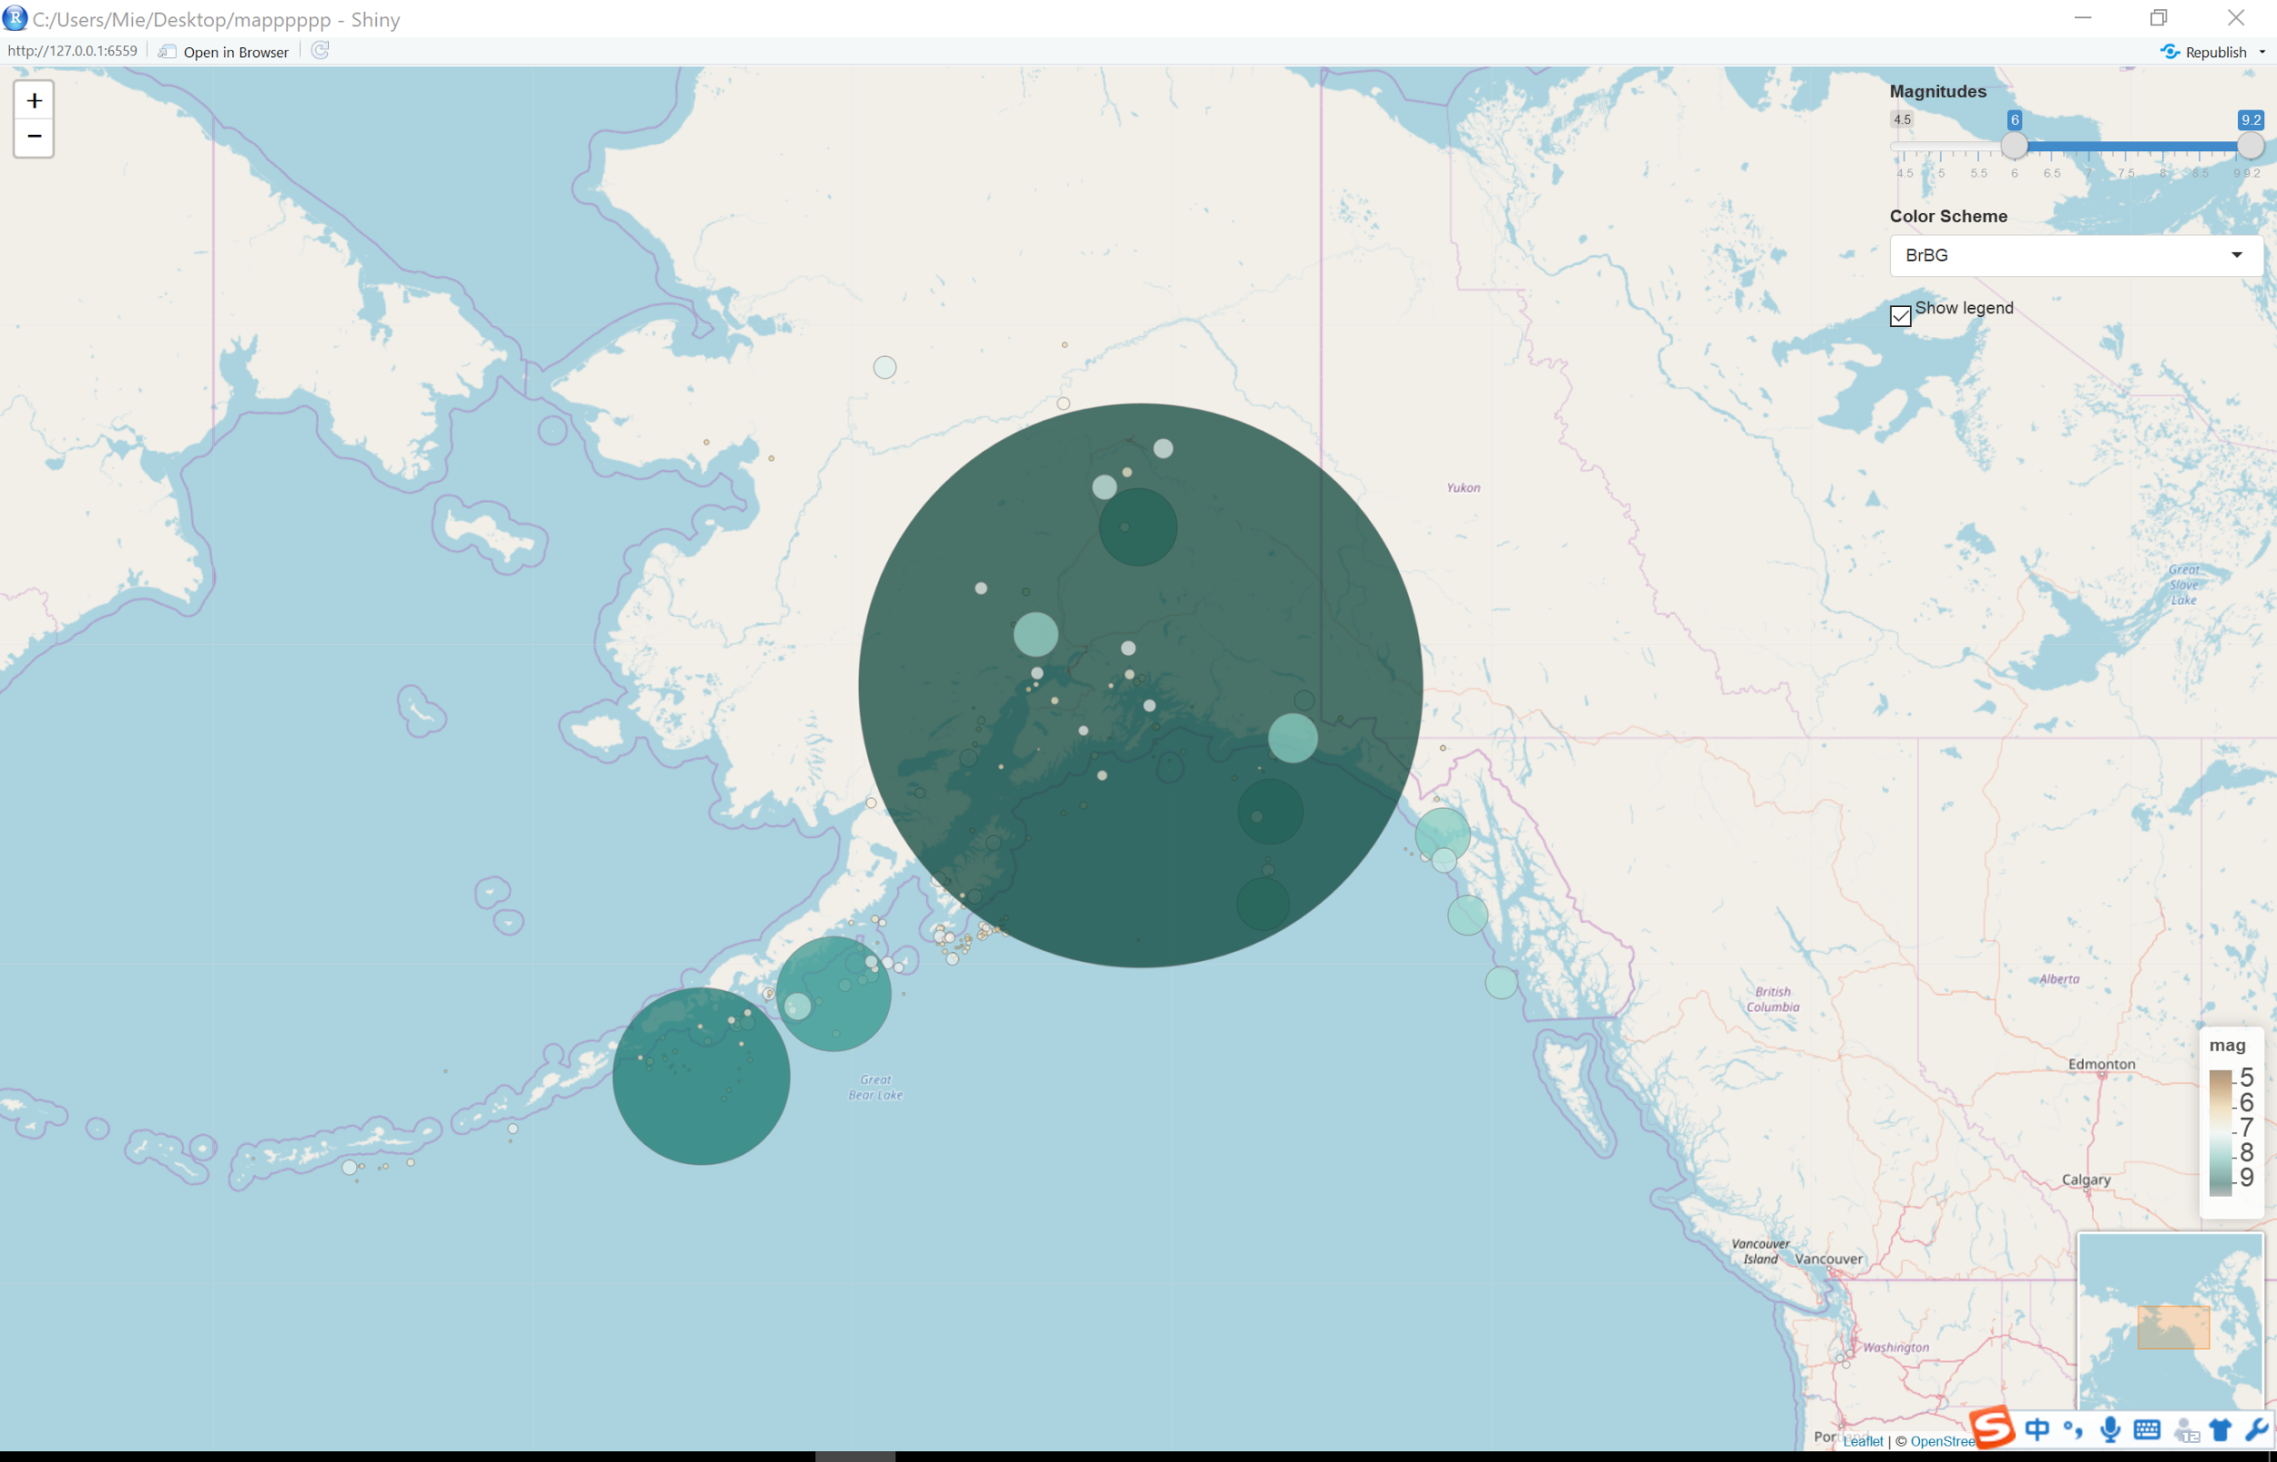
Alaska has several disastrous earthquakes.
Their magnitude are 7.7, 8.2, 8.6 and 9.2.

Slide 7
Explored by Countries

Slide 8
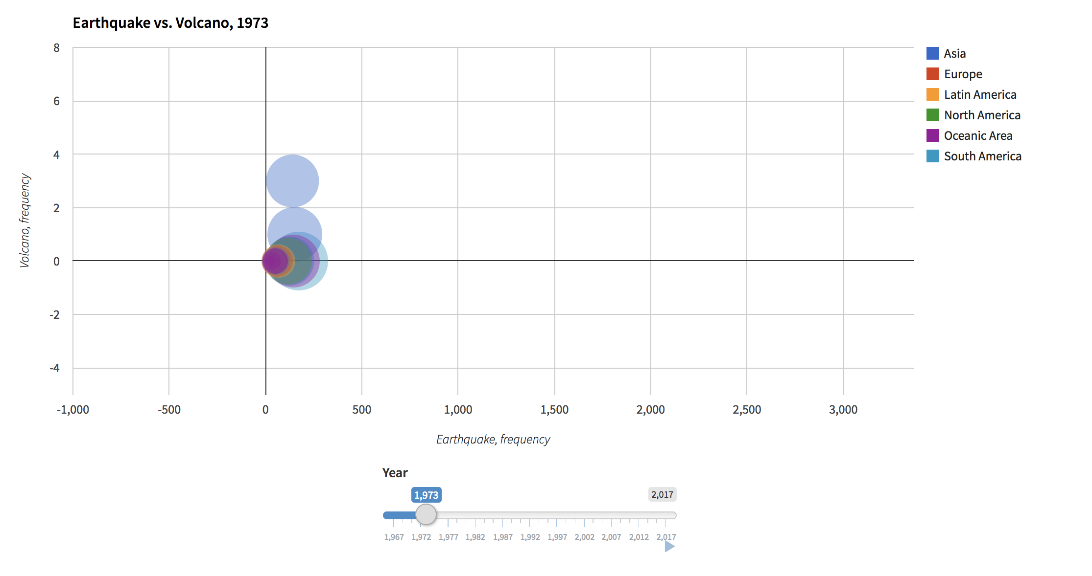
World’s leading disasters
Earthquake & Volcano & Tsunami
* Selected earthquake high frequency countries
* Colored by Region, shaded by country
* Separated by year
* Sized by frequency of Tsunami per year
* 3-D visualization on 3 world disasters
No absolute correlation
Highly frequency in Asia area

Slide 9
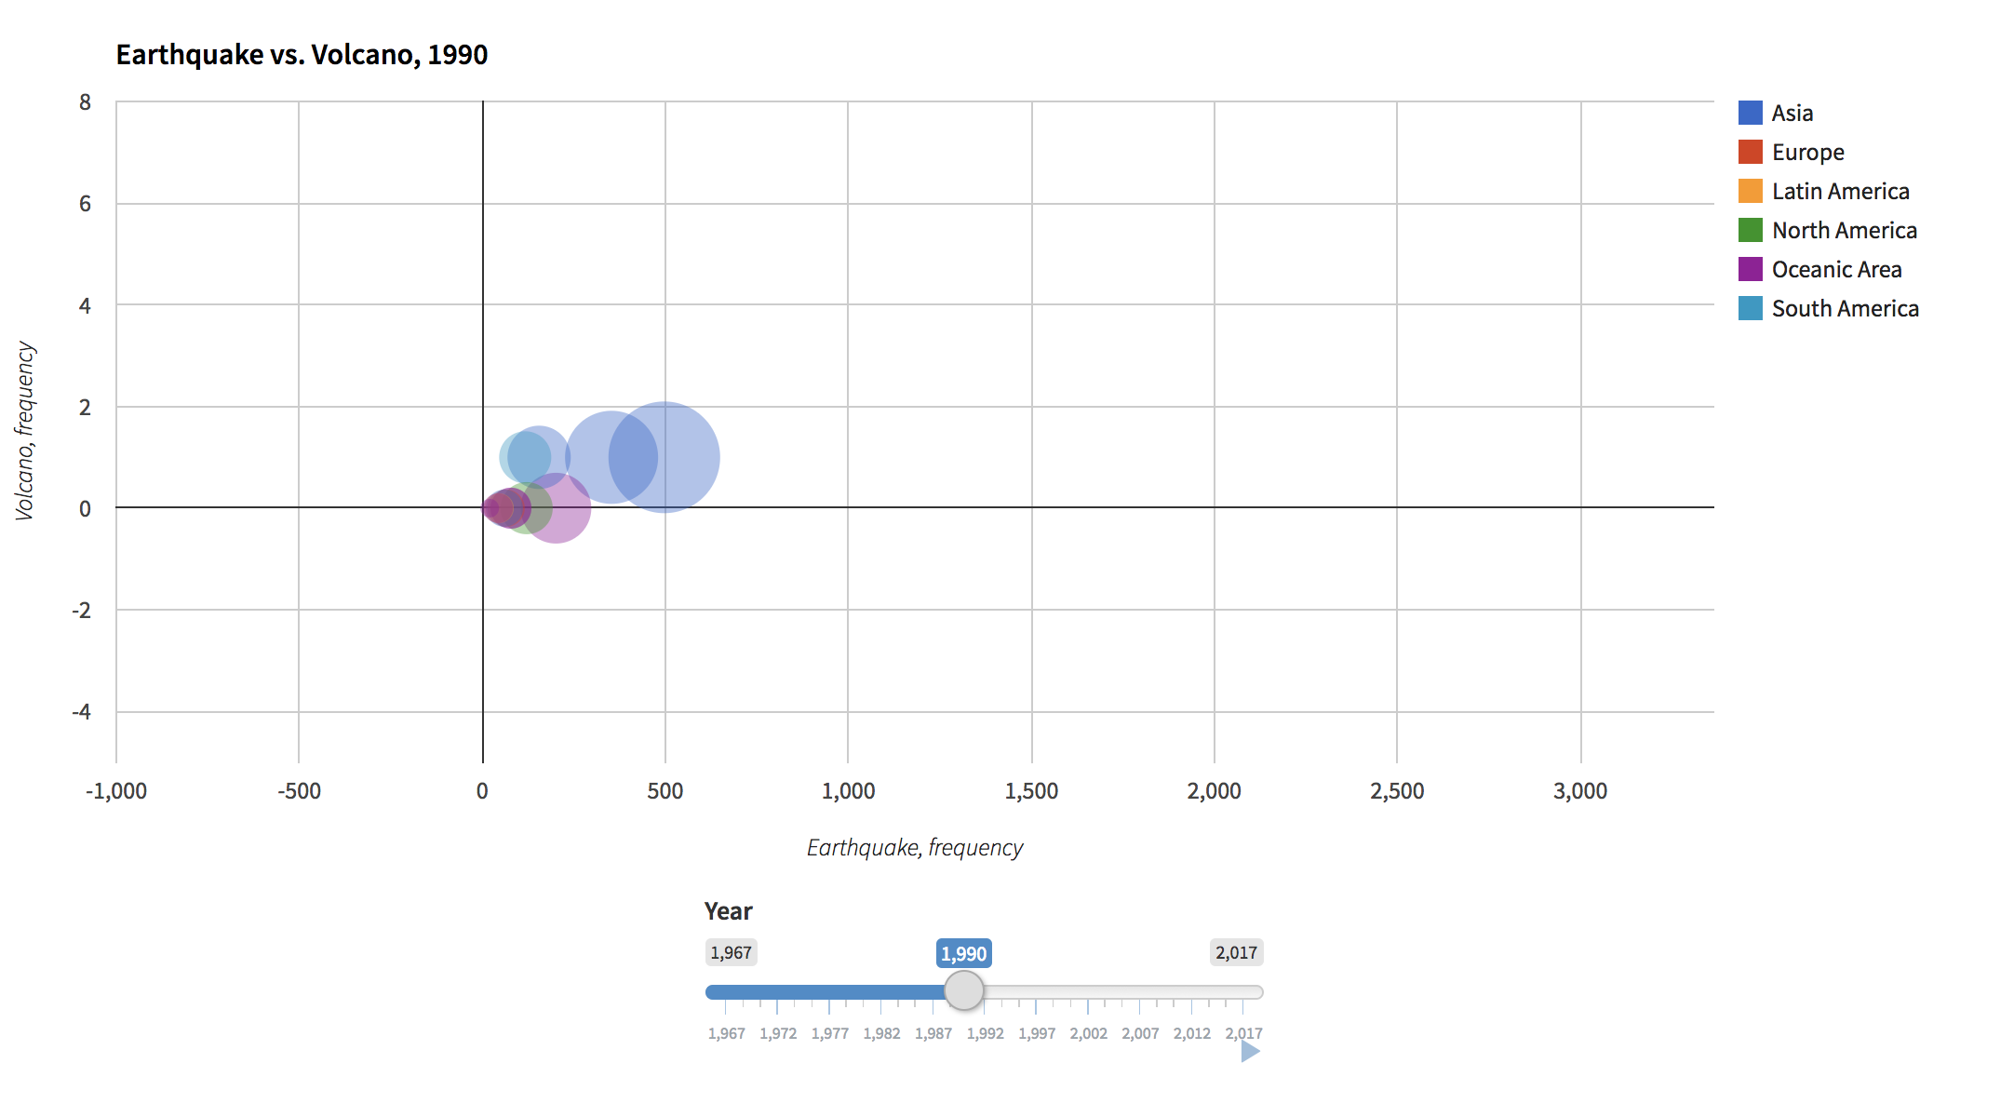
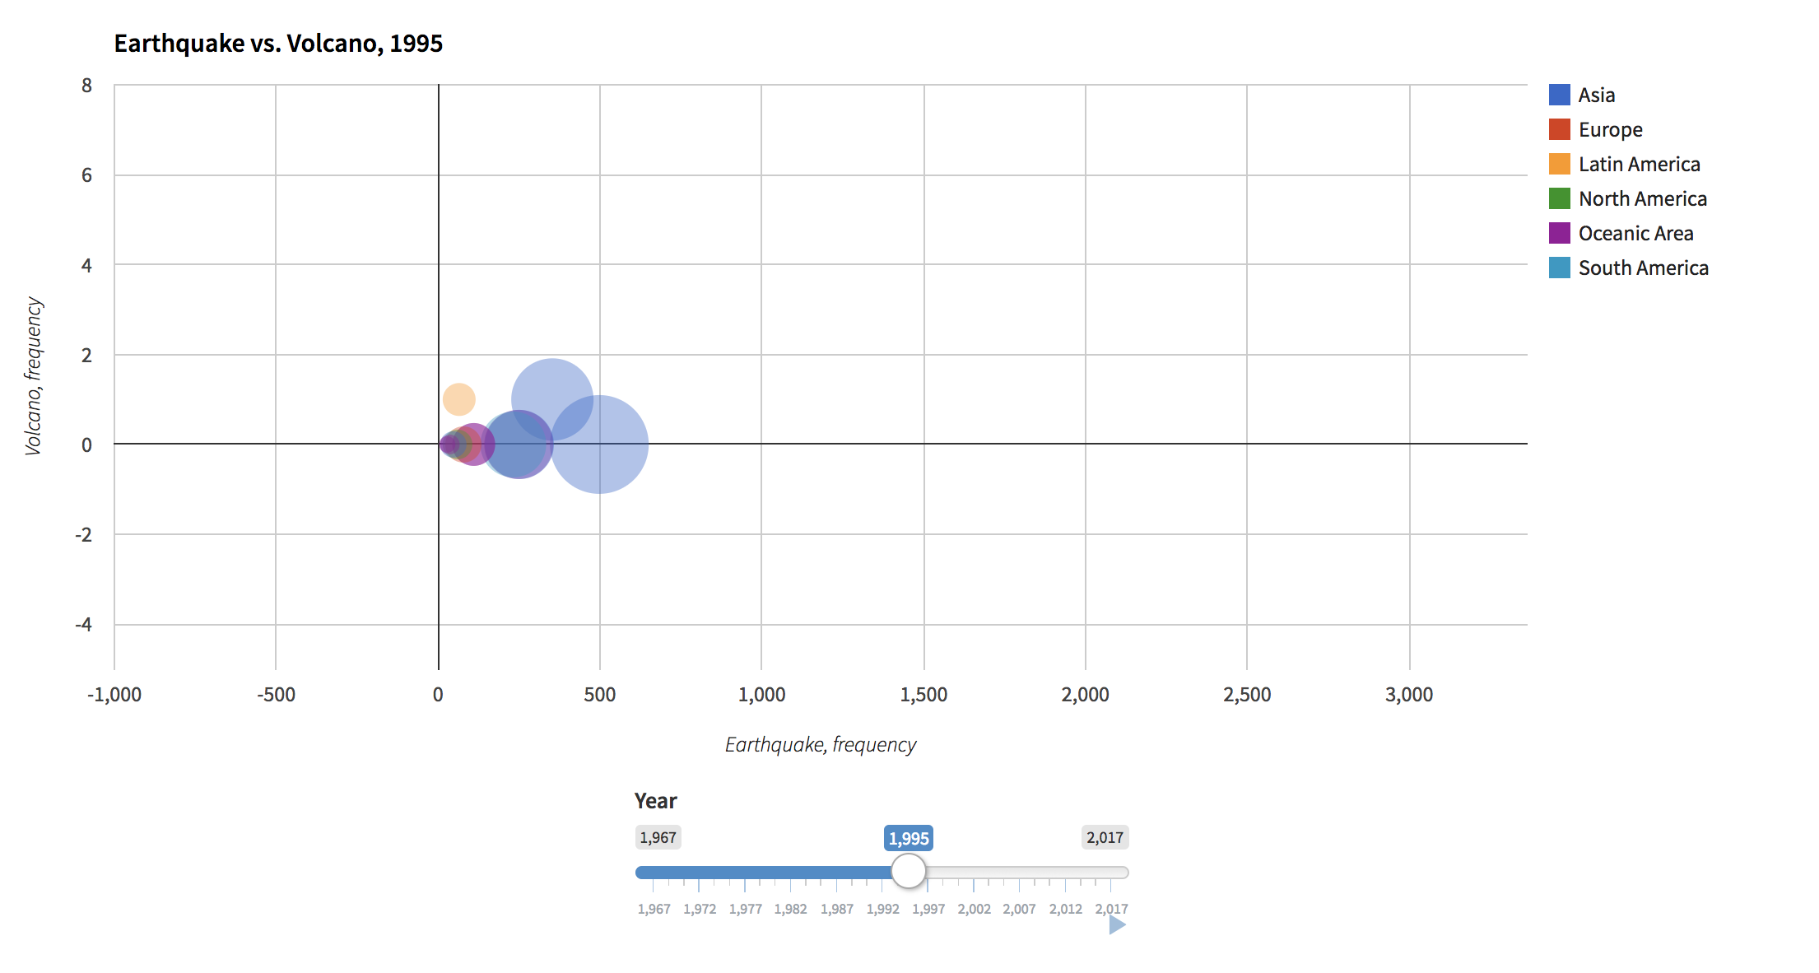
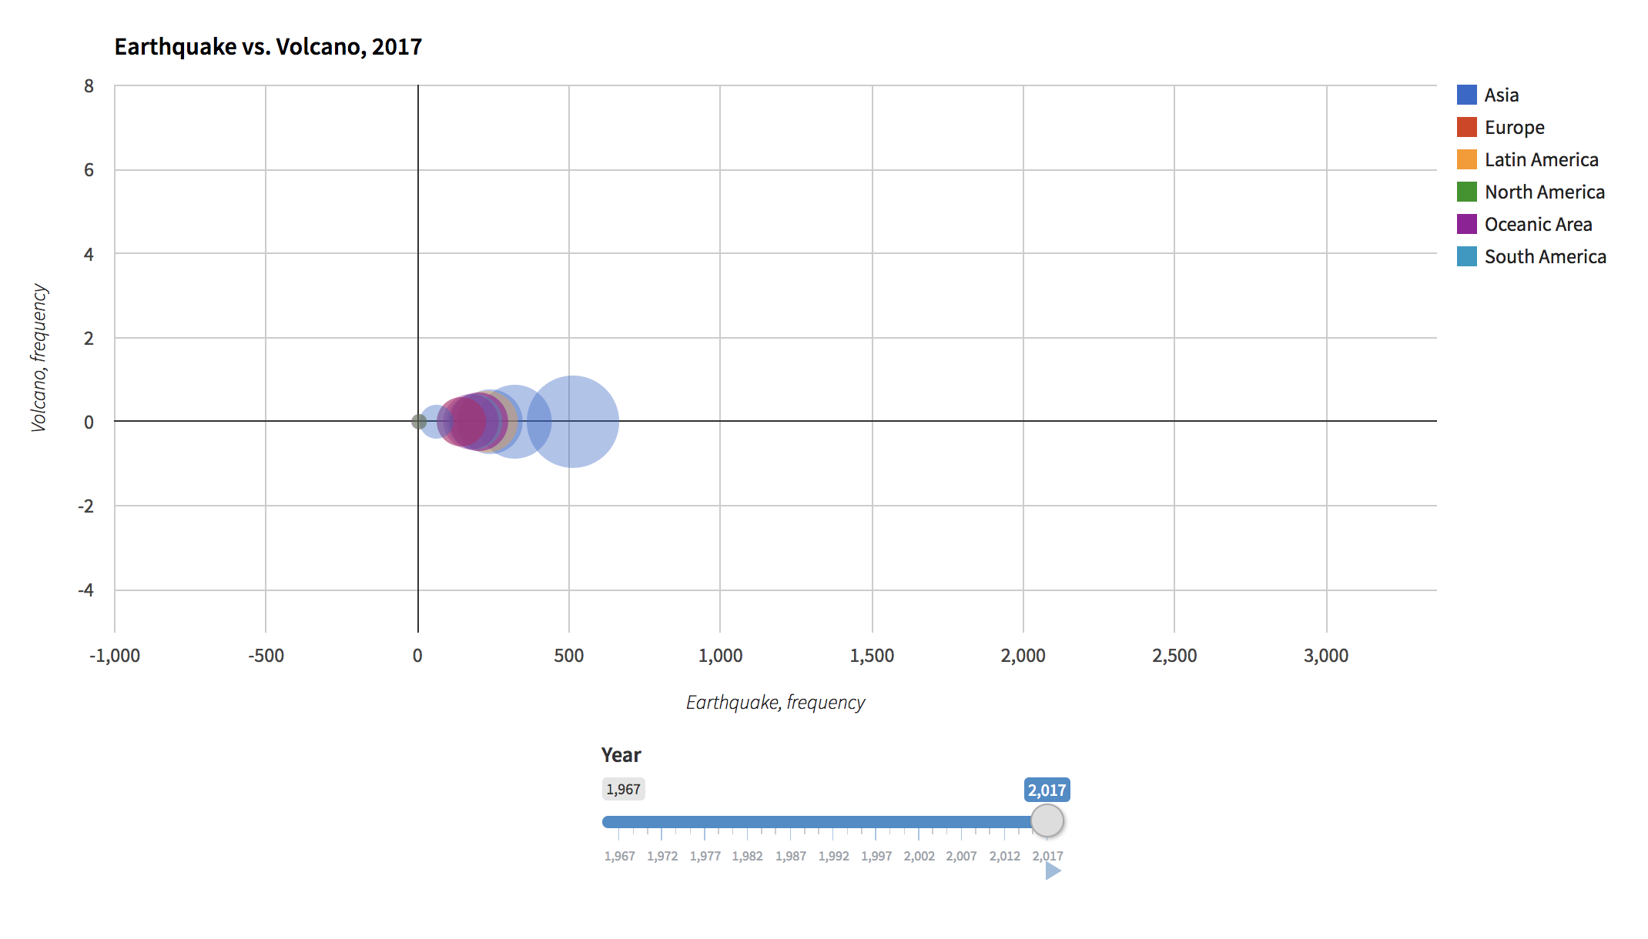
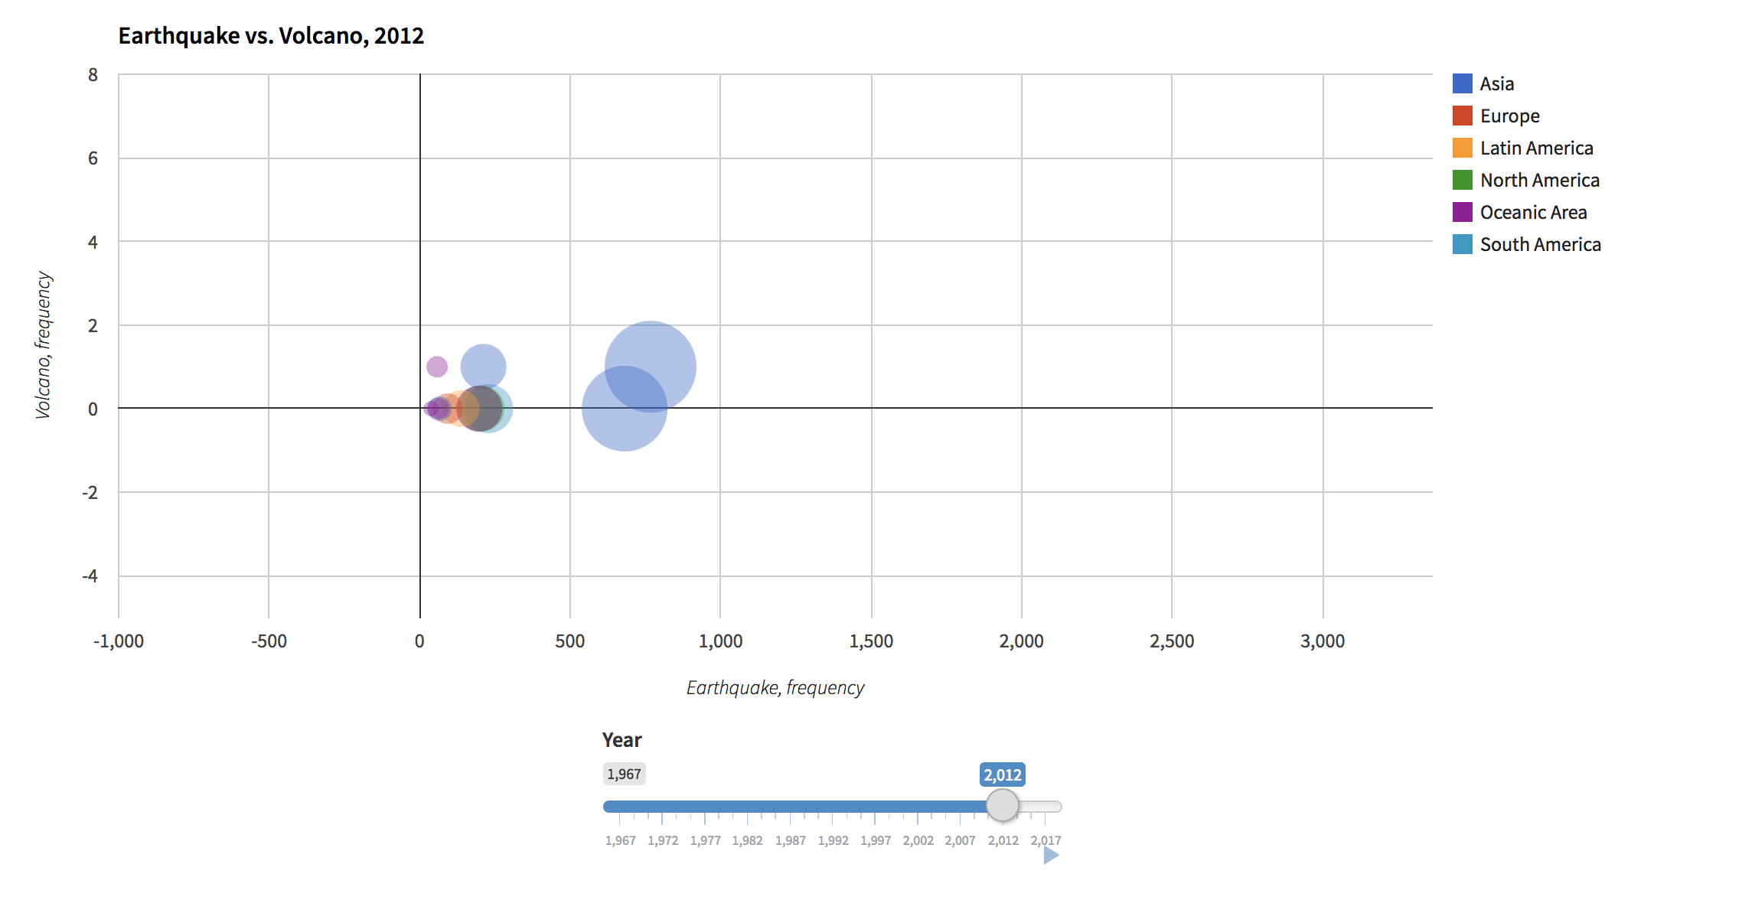

Slide 10
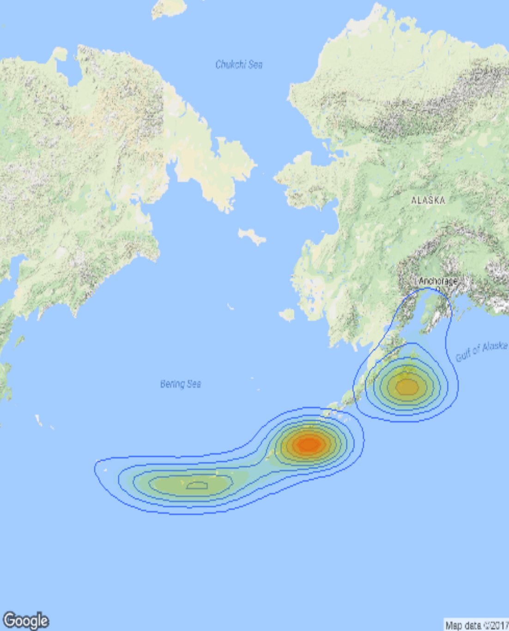
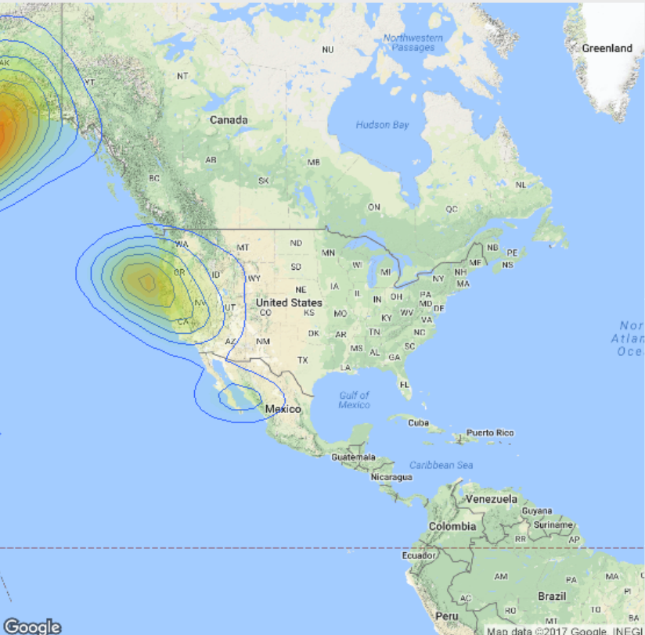
Hazard Map
logR =-0.2+0.36*mag
* Earthquake affected area: calculated radius by magnitude
* Locate to specific area
* Highlight area affected by earthquake: the deeper of the colour, the stronger of the effects
Reference: Bufe C G, Varnes D J. Predictive modeling of the seismic cycle of the greater San Francisco bay region. J. Geophys. Res.,1993, 98: 9871~9883.

Slide 11

Probabilistic Models
Model 1
Model 2
Methodology: The Gutenberg-Richter Magnitude Frequency
* Relationship Regression: log(N) = a + b * M
* Poisson Distribution : p = 1- Pr(event = 0)
* p1 : the of occurrence of at least one earthquake of magnitude >= Μ in the next t years.
* p2: We estimate the affected area of the earthquake by log(R) = -0.2 + 0.36 * M from Bufe C G, Varnes D J. We use the same method to recalculate the probability with the new parameter R.
N = the number of earthquakes with magnitude larger than M during a time period 50 years.
a = a constant that measures the total number of earthquakes at the given source
b = a measure of the number of small versus large events.
* a and b are coefficients of the regression
The number of events N can be divided by the T years in order to get the annual frequency of exceeding the M event magnitude: N1 (M) = N(M) / T

Slide 12

Conclusions
Help insurance rate adjustments
Help people become aware of the dangers they might face

Slide 13
Thank you.
Q & A

